Slide 1
Visual Programming
Project Report

Slide 2

Group Members
Fatima Rani
Owaif Amir
Malaika Batool

Slide 3
C# Language
Console Application

Slide 4

Shopping Cart System
Add and remove products from the cart.
View Cart.
Item Quantity Management
Calculate the total cost of items in the cart.
Apply discounts and sales tax.
Product Recommendations
Cart Expiration
Checkout Process

Slide 5
Key Classes
Product Class: Stores product details (ID, name, price).
CartItem Class: Holds a product and its quantity.
ShoppingCart Class: Manages the entire shopping cart.

Slide 6
Main Features
Product Management:
Display products.
Add products to the cart.
Cart Management:
View and manage items in the cart.
Update quantity or remove items.
Checkout: Calculate total cost with sales tax and discount.

Slide 7
Functions
Main

Slide 8
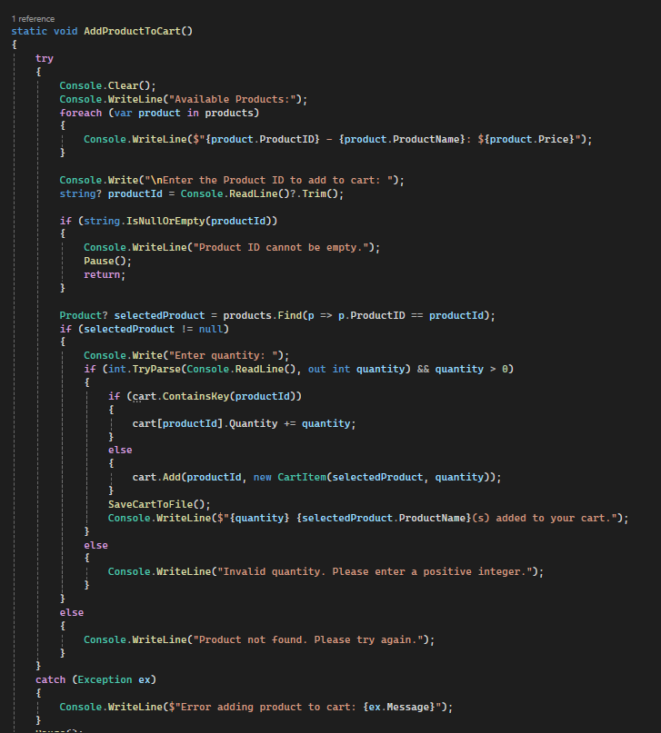
AddProductToCart():
User selects a product and quantity to add.
Updates existing items in the cart if added again.

Slide 9
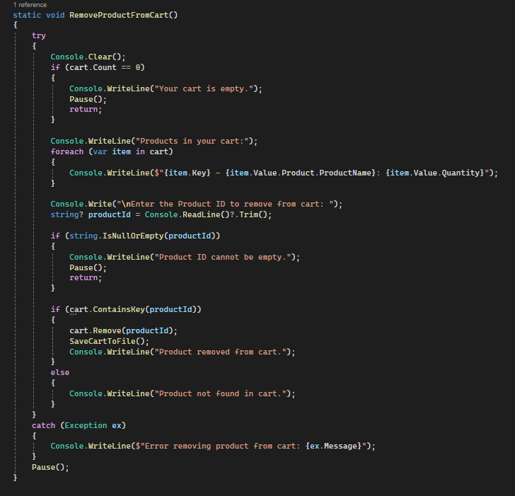
RemoveProductFromCart():
User removes items from the cart by entering the product ID.

Slide 10
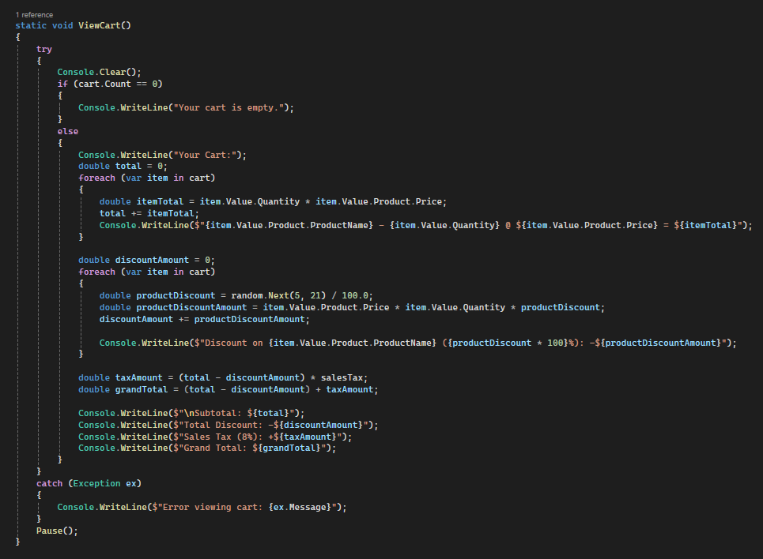
ViewCart():
Shows cart contents, calculates subtotal, discount, sales tax,
and grand total.

Slide 11
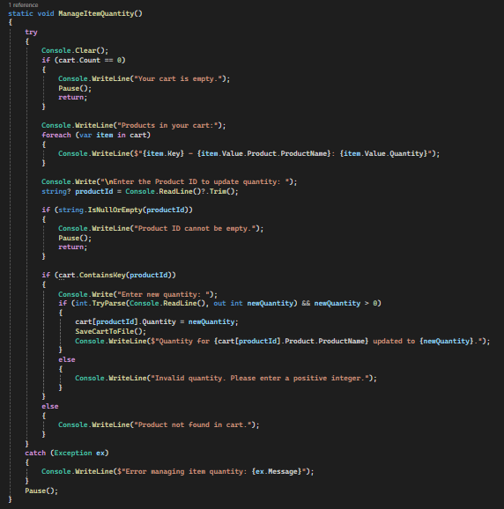
ManageItemQuantity():
Allows users to change quantities of items in the cart.

Slide 12
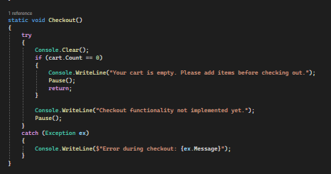
Checkout():
Displays the final cart total.

Slide 13
Special Features
Cart Expiration:
Clears cart if inactive for 30 minutes.
File Management:
Cart items are saved to a file and loaded when the app is reopened.

Slide 14
Error Handling
Purpose: To ensure the program continues running smoothly even when unexpected errors occur.
Implementation:
Try-Catch Blocks:
Surrounds code that might throw errors (e.g., adding products, viewing the cart).
Catch Block: Captures and shows a friendly error message if something goes wrong (e.g., “Error adding product to cart”).

Slide 15
File Handling
Purpose: To save and load the cart’s data, so it can be restored when the application is restarted.
Key Methods:
SaveCartToFile():
Writes each item in the cart to a file (cart.txt).
Each line in the file includes product ID, price, and quantity.
LoadCartFromFile():
Reads from cart.txt when the app starts.
Adds each item back to the cart, restoring the previous session.

Slide 16
List of Main Methods
InitializeProducts(): Adds predefined products to the product list.
AddProductToCart():
Allows users to add items to the cart by specifying a product ID and quantity.
Updates quantity if the product is already in the cart.
RemoveProductFromCart(): Removes a product from the cart based on its product ID.
ViewCart(): Shows cart items and calculates subtotal, discount, tax, and total.
ManageItemQuantity(): Updates the quantity of an item in the cart.

Slide 17
List of Main Methods
Checkout(): Displays the grand total and clears the cart after checkout.
Pause(): Pauses the program and waits for user input to continue.
IsCartExpired(): Checks if the cart has been inactive for over 30 minutes, and clears it if so.
SaveCartToFile(): Saves current cart items to a file.
LoadCartFromFile(): Loads previous cart items from the file when the app starts.

Slide 18

Thank You

